Slide 1

Predicting The Energy Output Of Wind Turbine Based On Weather Condition
Submitted By:
Antara Ray
Bratati Ghosh
Mohini Das
Tanisha Sarkar

Slide 2
Project Description
Wind energy plays an increasing role in the supply of energy world-wide. The energy output of a wind farm is highly dependent on the wind conditions present at its site. If the output can be predicted more accurately, energy suppliers can coordinate the collaborative production of different energy sources more efficiently to avoid costly overproduction.
Better prediction models for the upcoming supply of renewable energy are important to decrease the need of controlling energy provided by conventional power plants.
Hereby, we formulate the prediction task as regression problem and test different regression techniques such as linear regression, Random Forest and Long short term memory. In our experiments, we analyze predictions for individual turbines and show that a machine learning approach yields feasible results for short-term wind power prediction.

Slide 3
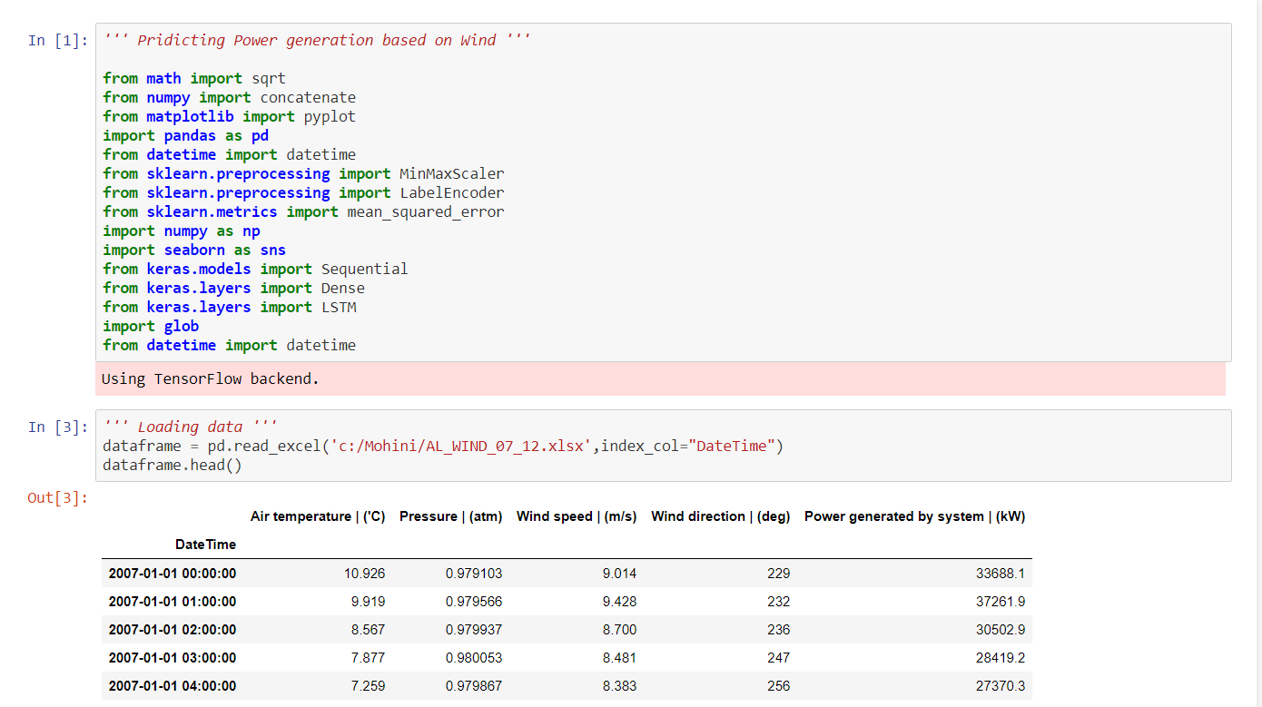
Data Collection
Data collection is the process of gathering and measuring information on variables of interest, in an established systematic fashion that enables one to answer stated research questions, test hypotheses, and evaluate outcomes. The data collection component of research is common to all fields of study including physical and social sciences, humanities, business, etc. While methods vary by discipline, the emphasis on ensuring accurate and honest collection remains the same . This part is created by Antara Ray.

Slide 4
Data Pre-processing
Data pre-processing in Machine Learning is a crucial step that helps enhance the quality of data to promote the extraction of meaningful insights from the data. Data pre-processing in Machine Learning refers to the technique of preparing (cleaning and organizing) the raw data to make it suitable for a building and training Machine Learning models. In simple words, data pre-processing in Machine Learning is a data mining technique that transforms raw data into an understandable and readable format.
Data preprocessing in Machine Learning is a crucial step that helps enhance the quality of data to promote the extraction of meaningful insights from the data. Data preprocessing in Machine Learning refers to the technique of preparing (cleaning and organizing) the raw data to make it suitable for a building and training Machine Learning models. In simple words, data preprocessing in Machine Learning is data mining technique that transforms raw data into an understandable and readable format.
Data Preprocessing is a technique that is used to convert the raw data into a clean data set. In other words, whenever the data is gathered from different sources it is collected in raw format which is not feasible for the analysis.
This section is created by Bratati Ghosh.

Slide 5
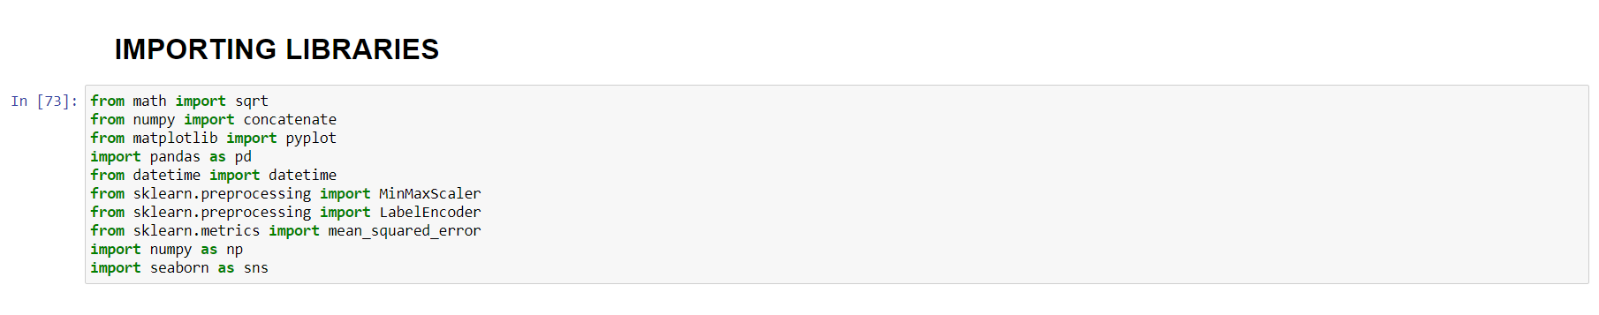
Importing Libraries
Since Python is the most extensively used and also the most preferred library by Data Scientists around the world, we’ll here use you popular Python libraries for data pre-processing in Machine Learning. The predefined Python libraries can perform specific data pre-processing jobs. There are three core Python libraries used for this data pre-processing in Machine Learning. They are: Numpy , Matplotlib , Pandas etc.

Slide 6
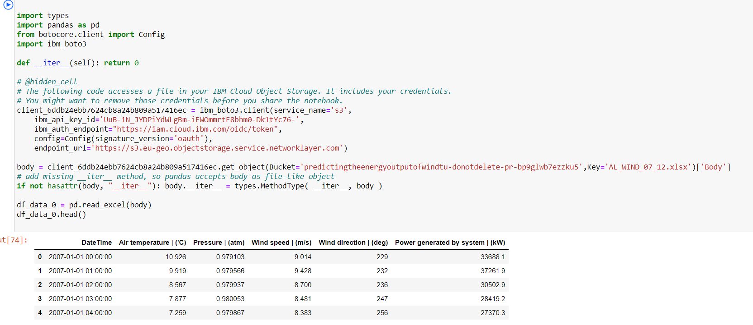
Importing Dataset
In this step, we need to import the dataset/s that we have gathered for the ML project at hand. However, before we can import the dataset/s, we must set the current directory as the working directory.
Here, we use Jupyter Notebook as our platform.
Once you’ve set the working directory containing the relevant dataset, we import the dataset using the “read_csv()” function of the Pandas library. This function can read a CSV file (either locally or through a URL) and also perform various operations on it. The read_csv() is written as:
data_set= pd.read_csv(‘dataset.csv’)
In this line of code, “data_set” denotes the name of the variable wherein you stored the dataset. The function contains the name of the dataset as well. Once you execute this code, the dataset will be successfully imported.

Slide 7
Handling Missing Values
In data preprocessing, it is pivotal to identify and correctly handle the missing values, failing to do this, you might draw inaccurate and faulty conclusions and inferences from the data. Needless to say, this will hamper your ML project.

Slide 8
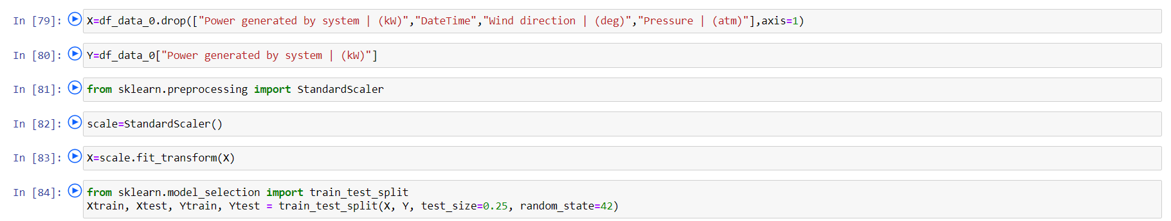
Splitting dataset
Every dataset for Machine Learning model must be split into two separate sets – training set and test set.
Training set denotes the subset of a dataset that is used for training the machine learning model. Here, you are already aware of the output. A test set, on the other hand, is the subset of the dataset that is used for testing the machine learning model. The ML model uses the test set to predict outcomes.
Usually, the dataset is split into 70:30 ratio or 80:20 ratio. This means that you either take 70% or 80% of the data for training the model while leaving out the rest 30% or 20%. The splitting process varies according to the shape and size of the dataset in question.Here, we use 60:40 ratio means we take 60% of data for training the model and rest 40% to test it.

Slide 9
Data Visualization
Data Visualization is the presentation of data in graphical format. It helps people understand the significance of data by summarizing and presenting a huge amount of data in a simple and easy-to-understand format and helps communicate information clearly and effectively.
Plot Types –
There are several plot types built-in to pandas, most of them statistical plots by nature:
df.plot.area
df.plot.barh
df.plot.density
df.plot.hist
df.plot.line
df.plot.scatter
df.plot.bar
This section is created by Tanisha Sarkar.

Slide 10
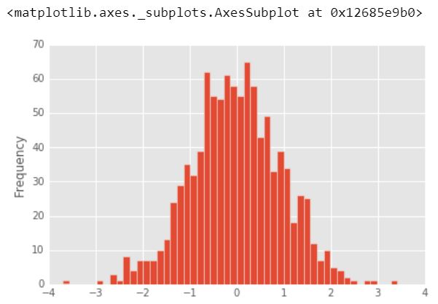
Histogram
A histogram is a plot that lets you discover, and show, the underlying frequency distribution (shape) of a set of continuous data. This allows the inspection of the data for its underlying distribution (e.g., normal distribution), outliers, skewness, etc.

Slide 11
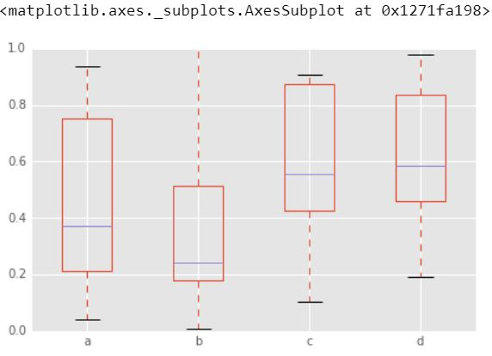
Box Plot
It is a plot in which a rectangle is drawn to represent the second and third quartiles, usually with a vertical line inside to indicate the median value. The lower and upper quartiles are shown as horizontal lines either side of the rectangle. A boxplot is a standardized way of displaying the distribution of data based on a five number summary (“minimum”, first quartile (Q1), median, third quartile (Q3), and “maximum”). It can tell you about your outliers and what their values are. It can also tell you if your data is symmetrical, how tightly your data is grouped, and if and how your data is skewed.

Slide 12
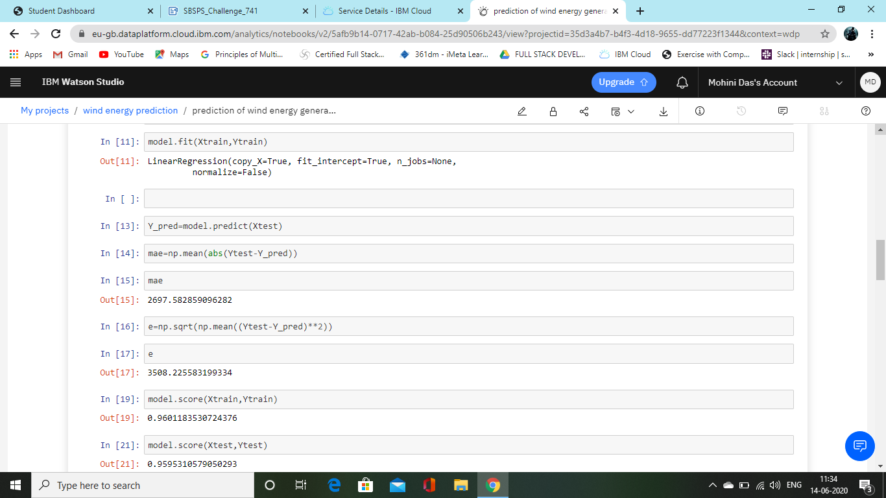
Model Building
Linear Regression:
It is used to estimate real values (cost of houses, number of calls, total sales etc.) based on continuous variable(s). Here, we establish relationship between independent and dependent variables by fitting a best line. This best fit line is known as regression line and represented by a linear equation Y= a *X + b.
The best way to understand linear regression is to relive this experience of childhood. Let us say, you ask a child in fifth grade to arrange people in his class by increasing order of weight, without asking them their weights! What do you think the child will do? He / she would likely look (visually analyze) at the height and build of people and arrange them using a combination of these visible parameters. This is linear regression in real life! The child has actually figured out that height and build would be correlated to the weight by a relationship, which looks like the equation above.
In this equation:
Y – Dependent Variable
a – Slope
X – Independent variable
b – Intercept
These coefficients a and b are derived based on minimizing the sum of squared difference of distance between data points and regression line.
This section is created by Mohini Das.

Slide 13
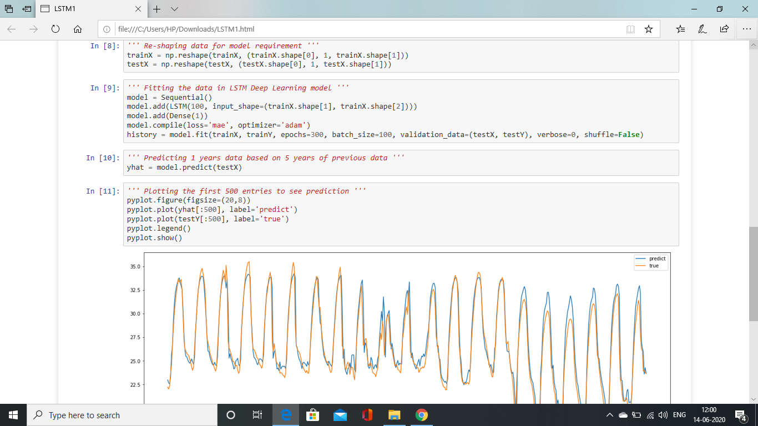
Time Series Analysis
LSTM
Screenshot
Long short-term memory (LSTM) is an artificial recurrent neural network (RNN) architecture used in the field of deep learning.LSTM networks are well-suited to classifying, processing and making predictions based on time series data, since there can be lags of unknown duration between important events in a time series.
For our project the LSTM was the best model to predict the expected energy output. As the RMSE was 1.562 and Accuracy score was 0.972.
This section is created by Mohini Das.

Slide 14
Future Scope
Models for Wind Power Ramp Forecasting: The variability in wind power can present a substantial challenge to the grid, when the penetration of wind power is high. The ramp event is a very critical issue and is characterized by a sudden large change (increment or decrement) in wind power. Accurate models for ramp event detection and forecasting is important for maintaining the stability of electrical grid.
Estimation of Forecast Uncertainty Uncertainty: Analysis of the wind forecasts made plays a key role in grid integration and other power system operations.
Use of Wind Power Forecasting in Power System Operations: Accurate models for wind power forecasting aids in several power system operations like operating reserve requirements, unit commitment, dispatch formulations etc.
Condition Monitoring of Wind Farms: Good performing forecasting models for wind power and wind turbine power curve models can also be used as performance indicator for the health of a wind turbine.
Wind Forecasting and Offshore Wind Farms: Due to limited land area in several regions, many countries are already into offshore wind farms. These offshore wind farms have opened up huge prospects of research in operation, maintenance, control of wind farms and wind resource assessment to identify potential sites etc.
This section is created by Mohini Das.

